Slide 1
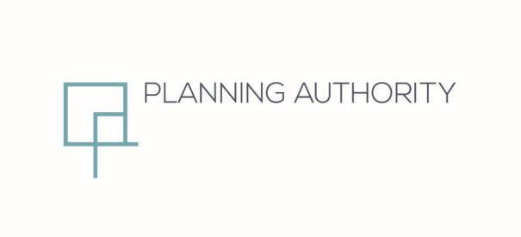
Partial Review of the Development Control Design Policy, Guidance and Standards 2015
Policy P35 (Building Heights)
Final Draft
October 2024

Slide 2
Setting the Scene
Step 1
Update the Executive Council following Phase 2 Public Consultation of the amended Policy P 35 (Building Heights)
Step 2
List Main issues raised in public consultation
Step 3
Determine Way Forward

Slide 3
Main issues raised in the Public Consultation
Issue 1
First draft of partial review issued for a second round of public consultation over a 6 weeks period between 6th May 2024 to the 17th June 2024.
Issue 2
A total of 4332 submissions were received. Out of this number, seven submissions were in agreement. The overwhelming majority objected. Notable amongst them were the Malta Development Association, Marsaskala Residents Network, The Archaeological Society Malta, Ghaqda Residenti Taz-Zurrieq, Wirt Ghawdex, Merill Rural Network, Birzebbuga Local Council, Moviment Graffitti, Wirt iz-Zejtun, Ramblers Association of Malta, Friends of the Earth Malta, Kamra tal-Periti, Din tal-Art Helwa, Gozo Regional Development Authority, Ghawdix, The Malta Chamber, Zminijietna Malta and Malta Sociological Association.

Slide 4
Main issues raised in the Public Consultation
Most objections (3224) were sent through the Din l-Art Helwa platform with a standard text. They noted that the revision would increase the number of floors from those stipulated and deemed permissible through the Local Plans. The policy would mostly affect streets with a predominance of two floors. Recommended that original text of policy is retained.
Issue 3
Issue 4
39 responses objected to the increase in the number of floors and to a change which has a direct
impact on the existing islands’ infrastructure due to the increase in density.
181 complained on incomplete text and absence of Annex 2. They also called for the retention of the
minimum internal height requirements as specified in the Sanitary law. UCAs are to be exempted from
the policy revision. Height limitations set in Local Plans to be respected.
Issue 5

Slide 5
Main issues raised in the Public Consultation
Issue 6
Issue of ‘contextuality’ and ‘urban grain’ highlighted. This was backed by recent court rulings on the subject.
A particular NGO commented on potential increase in population density, increase in traffic and vehicular noise pollution, greater strain on islands’ infrastructure and increased noise and light pollution
Parliamentary Committee for the Environment, Climate Change and Development Planning . Members of Opposition disagreed with proposed amendments as they were always against Annex 2. Proposal gives rise to wide interpretations contrary to the spirit of Local Plans. Issue for density and sustainability studies spelled out. Called for Local Plan review exercise to commence immediately.
Issue 7
Issue 8

Slide 6
DC 15 Policy P35
One of the most meaningful changes P35 stipulating that building heights should be measured in metres only instead of floors as specified in the Local Plans. This was complemented by Annex 2 ‘Interpretation of Height Limitation’ which enabled the conversion of the building height limitations in the Local Plans into overall height in metres.

Slide 7
Policy P35 is being retained as per amended version issued for public consultation:
A building shall not exceed the permissible height as established in the Local Plans, which shall be interpreted according to Annex 2 of this document. Such height shall be measured from the pavement level along the frontage of the building at the highest street level and will include the provision for any setback floors and services, as well as an obligatory 1-metre parapet wall on the exposed façades at the uppermost roof level (Figure 45). The only vertical structures that may be considered beyond the height limitation will be Wind Turbines (as defined within the Micro Wind Turbines policy), Telephony/Communication Antennae and flagpoles. The height of the street façade is arrived at by deducting 3.4 metres from the maximum allowable height provided in Annex 2.
Within the maximum height limitation, each floor shall have a minimum clear internal height in accordance with Sanitary Law.
Continued in the next slide

Slide 8
Policy P35 is being retained as per amended version issued for public consultation:
Interpretation of building height limitations outside villa/bungalow areas
Where the proposed building has a street façade of at least 12 metres, the uppermost floor above such height will be setback from the street façade. Such setback will be determined using the sight line principle, provided that it is never less than 3 metres. A sight alignment is to be taken from a point at 1.6 metres height located at the opposite side of the street to the building height along the building alignment and extended until it meets the maximum height defined in the Local Plans. Figure 46 illustrates the setback for the uppermost floor located above a street façade of 12 metres, 14.1 metres and 21.6 metres, for different street widths. Note that in the case of:
• A street façade up to 6.4 metres, where the total height is up to 9.8 metres – no more than three levels above highest pavement level will be allowed.
• A street façade of more than 6.4 meters and up to 10.1 metres, where the total height is more than 9.8 meters and up to 13.5 metres – no more than four levels above highest pavement level will be allowed.
Continued in the next slide

Slide 9
Policy P35 is being retained as per amended version issued for public consultation:
• A street façade of more than 10.1 meters and up to 14.1 metres, where the total height is more than 13.5 meters and up to 17.5 metres – no more than five levels above highest pavement level will be allowed.
For street facades higher than 14.1 meters, where the total height is more than 17.5 meters, the allowable number of number of levels above highest pavement level will be determined on the basis of the Sanitary Law and other provisions of this document.
Interpretation of building height limitations for villa/bungalow areas
The height for bungalow and villa developments will be established by offsetting the gradient derived from the site by 4.75 metres in the case of bungalows and 8.5 metres in the case of villas (excluding roof structures, in line with Policy P39), measured from the building line. (Figure 47). The existing site levels must be established by the Authority’s Land Survey Unit. Particular regard is to be given to the roofs of surrounding buildings in order to tie in as closely as possible with these roofs.
Continued in the next slide

Slide 10
Policy P35 is being retained as per amended version issued for public consultation:
Interpretation of building heights in Urban Conservation Areas
In the case of Urban Conservation Areas, the assessment of building heights on the street façade will be based on the streetscape analysis as established in Policy P4. Additional levels above this height will be assessed on the basis of Policy P39.
When buildings face open areas including piazzas and the countryside or are seafront, a setback of at least 4.25 metres will be required (Figure 48).
Policy P35 is being retained as per amended version issued for public consultation:

Slide 11
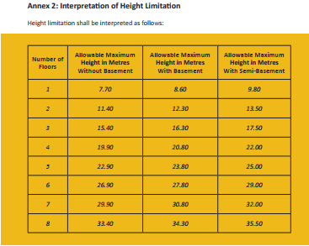
Annex 2

Slide 12
Recommendations based on responses:
Recommendation 1:
The proposed revision aims to provide more clarity and assurance when it comes to the allowable height limitation. This point effectively ties with the first and primary policy in DC15, policy P1-Extent of Commitment in DC 15. This uniquely important key policy does not merely define commitment as those existing legal developments that are physically present on site and valid planning commitments. It goes on to include ‘any future commitments provided by the Local Plans, even if the commitments are yet unbuilt.
Recommendation 2:
This actual detail supports the Authority’s consistent argument that DC 15 and more definitively the revised P35 has been aligned to the overarching Local Plan policies. The DC15 policy P1 considering ‘commitment’ to include Local Plan provisions is so vital that policy P4 (applying height to width ratio in Urban Conservation Areas) underscores the fact that for the application of P4 only, the extent of existing commitment is defined more narrowly.

Slide 13
Recommendations based on responses:
Recommendation 3:
Recent conflicting court interpretation of planning law has created a climate of uncertainty and inconsistency within the planning/ development environment. Such court decisions have declared the prevalence of Local Plans above more recent policy guidance documents like DC 15. An uneven playing field has also been created where cases which make their way to the Courts (when planning disputes arise) are having their overall height reduced when other neighboring properties, which are not objected to, proceed to construct the number of levels as originally approved ultimately result in the incongruous streetscapes which the judicial process is supposedly attempting to prevent. This must be viewed against a common background of Local Plan policies coupled with the Development Control Design Policy Guidance and Standards 2015.
It is now evident that such a policy revision is urgently needed to create a fair and even development management system with a clearer and unambiguous policy reflecting the original spirit of the same policy.
Recommendation 4:

Slide 14
Way Forward
At its meeting held on 22nd October 2024, the Executive Council approved the proposed amendments to the Provisions of Policy P35 of the Development Control Design Policy Guidance and Standards 2015 following Phase 2 public consultation without any changes, and forwarded the policy documents to the Minister for Gozo and Planning for final approval, in terms of Article 53(2)(c) of the Development Planning Act (Chapter 552).

