Slide 1
Partial Review of the GCLP (2006) Ghajnsielem and Xewkija
Public Consultation Draft
Presentation to the Parliamentary Standing Committee for the Environment, Climate Change and Development Planning
9th April 2025

Slide 2
SCOPE
To provide background for the partial review
To list the main issues of public concern
To present the revisions to the GCLP

Slide 3
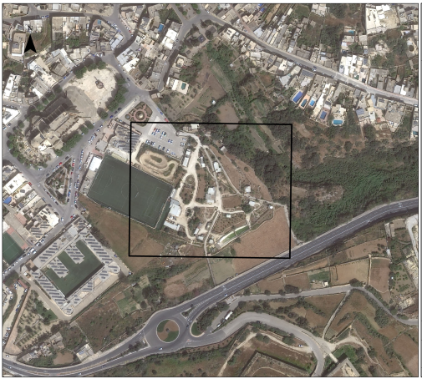
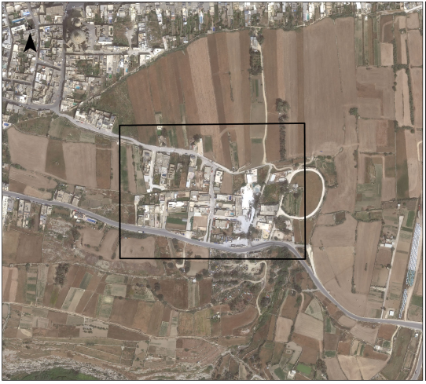
Ta’ Passi
Ghajnsielem
Torri Gorgun
Xewkija

Slide 4
OBJECTIVES
The Objectives for the Partial Local Plan Review of the Gozo and Comino Local Plan (2006) for the area of Ghajnsielem and Xewkija, put forward by the Minister are as follows:
To designate a specific site within the broad area depicted on Map 1 at Ghajnsielem as an open air, formal recreational land use with ancillary structures. The site-specific policy should include development criteria to ensure that the site remains used solely for formal recreational with minimal commercial activity forming an integral part of the recreational land use, remain predominantly open and landscaped, any ancillary structures remain small in scale and their design and location within the site do not create unacceptable impacts.
2. To designate the area located between Triq it-Torri Gorgun and Triq il-Kav. Lorenzo Zammit Haber, Xewkija, broadly indicated on Map 2, as a Rural Settlement and clearly delineate the development boundary, identify the developable land within the boundary, public roads, the acceptable land-uses and building height limitations within the overall framework of the Gozo and Comino Local Plan, provided that additional development on vacant land is strictly controlled.
3. To amend or delete all other provisions in the Gozo and Comino Local Plan of 2006 which are deemed to run counter to the overall objectives set out in paragraphs (1) and (2) above.

Slide 5
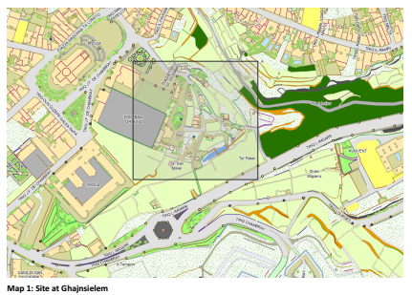
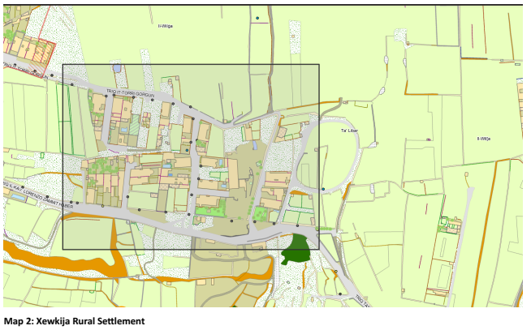
Project analysis slide 2
OBJECTIVES

Slide 6
PUBLIC CONSULTATION
Public Consultation on Objectives held between the 15th of October and 6th of November 2024, generated 63 submissions
5 of the submissions were from public entities and NGOs
3 submissions related to Ghajnsielem
60 submissions related to Xewkija

Slide 7
GHAJNSIELEM BACKGROUND
Relates to an area known as Ta’ Passi where the annual Betlehem f’Ghajnsielem has been organised since 2008,
Over the years attractions increased to include; a bakery, old trade shops like carpenter and blacksmith, a tavern offering local food, an open-air market, a small river and the grotto,
Organisers applied for a temporary planning permission to test up the structures related to the event,
It is a Government objective to designate this site as a permanent open air formal recreational area with ancillary structures with minimal commercial activity that supports the overall use of the site.

Slide 8
GHAJNSIELEM - 1st STAGE PUBLIC CONSULTATION MAIN ISSUES
To designate the area known as Ta’ Passi as a site for informal recreation with passages connecting paved areas and water features,
Paved areas to accommodate structures related with seasonal activities,
To develop to permanent buildings ancillary to the activities carried out within the site,
Extension to the existing football ground,
A community centre with underground carparking,
To develop an existing parking area as an extension to the community centre and sports facilities,
To limit the formal recreation to the area used for the nativity village,
Structures should be small and temporary,
Ensure that site does not become a development zone,
To carry out a social impact assessment.

Slide 9
GHAJNSIELEM – NEW POLICY
A new policy that designates Ta’ Passi for formal recreation is required
GZ-Ghjn-18:
The local plan designates the area known as Ta’ Passi as depicted on MAP 14.2G, as a formal recreational area. Within this site, the policy designates a sub-zone for formal recreation facilities ancillary to the existing football ground, for which provisions of general policy GZ-RECR-6 shall be applicable. The remaining of the indicated site shall be subject to the following conditions:
A comprehensive development application covering all the site indicated on Map 14.2G but excluding the area within the site designated for formal recreation ancillary to the existing football ground, is submitted to the Planning Authority in accordance with the provisions of this policy,
an area of not less than 65% of the total site area (excluding the area for ancillary sports facility) remains predominantly open. Only planting of maquis or archaeophytic fruit trees typical of rural settings shall be allowed within this area
the proposal shall include one or more circular routes to serve as passageways and interspersed seating areas together with water features as part of the predominantly open area but that do not occupy more than 27% of the total site area (excluding the area for ancillary sports facility),

Slide 10
GHAJNSIELEM – NEW POLICY
all passageways are constructed with permeable material that allows runoff water to seep through,
the proposal shall include small scale built roofed-over ancillary structures provided that:
  comprehensively they do not exceed 8% of the total site area (excluding the area for ancillary sports facility),
  the proposal may include two permanent structures as indicated on Map 14.2G which can accommodate Class 4B, 4C and 4D commercial uses as indicated by the Development Planning (Use Classes) Order of 2014, provided that these structures do not exceed an overall building height of 7.7 metres,
  the proposal may also include additional low-lying built and roofed over structures ancillary to the formal recreation and the seasonal activities that may be organised within the area. These structures must not exceed an overall footprint of 145 sqm and a building height of 3.4 metres each,
  the proposal ensures that the design and the location of the ancillary buildings within the site do not create unacceptable impacts. It is encouraged that these structures are screened by landscaping as indicated in (b) above,
  given its location, the use of traditional materials (e.g. timber and weathered stone) will be encouraged in order to convey an informal rural character.
lighting shall consist of full cutoff downlighters with a colour temperature of 2500-3000L and also according to the provisions of GC-UTIL-5. Lighting on high poles and/or floodlighting shall not be permissible.

Slide 11
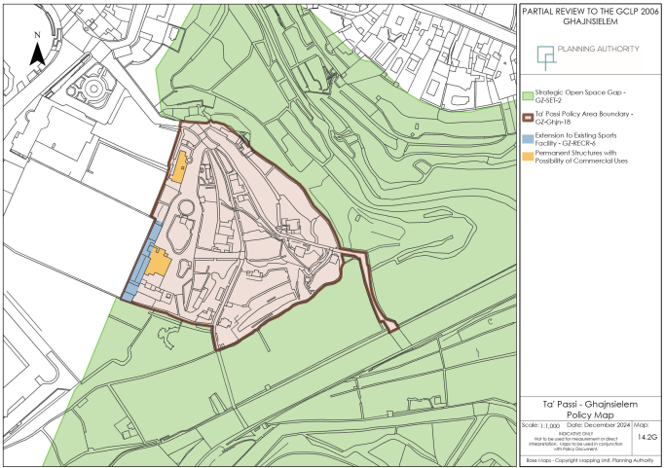
Project analysis slide 2

Slide 12
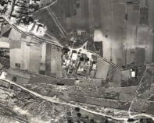
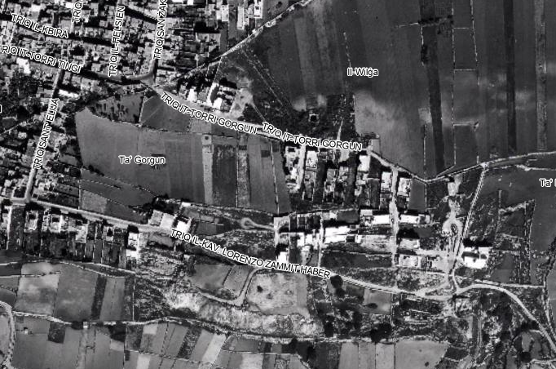
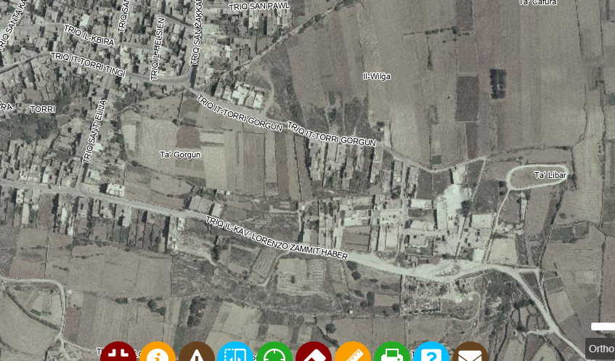
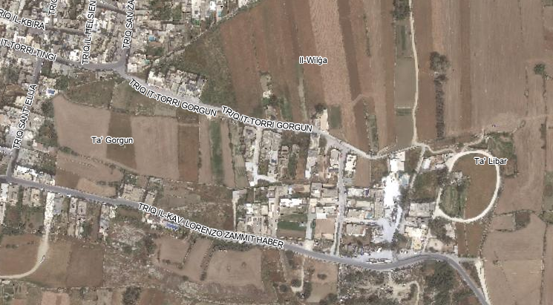
XEWKIJA – BACKGROUND
Development within the area known as It-Torri Gorgun appears first on the aerial photographs of 1978,
Development continued to increase and by the year 1994 it reached the level of development that is present today, with smaller additions up to the year 2004,
Considerable areas of vacant land,
It is an objective to designate the built areas as a rural settlement in order to contain urban sprawl and thus protect the undeveloped areas from further development.
Partial Review intended to revise Local Plan policies related to Category 2 and 3 rural settlements,
GCLP policies GZ-RLST-2 & GZ-RLST-3
NWLP policies NWRS 3 & NWRS 4
CMLP policy CG04
SMLP policies SMSE07 & SMSE08
1978
1994
2004
2024

Slide 13
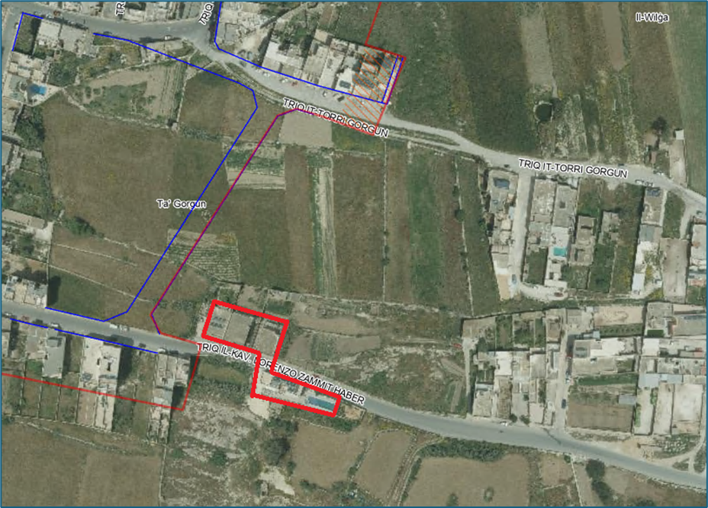
XEWKIJA - 1st STAGE PUBLIC CONSULTATION MAIN ISSUES
57 out of these 60 submissions supported the objective to designate the site as a rural settlement and delineation of development boundary, building heights, and strict control on vacant land,
An additional two clusters to be also included as rural settlement category 1 and the settlement indicated by the review map to be included as a category 2,
To carry out a social impact assessment,
Partial Review intended to revise Local Plan policies related to Category 2 and 3 rural settlements,
GCLP policies GZ-RLST-2 & GZ-RLST-3
NWLP policies NWRS 3 & NWRS 4
CMLP policy CG04
SMLP policies SMSE07 & SMSE08
Objections to the designation of a rural settlement since development in the area is post 1968 and there are several pending enforcement notices,
Restrict land take up in rural areas,
Review undermines the obligation that one adheres to the laws and planning policies

Slide 14
XEWKIJA – REVISED POLICY
Policy GZ-RLST-1 that identifies the Category 1 rural settlements is also being revised in order to also include this new settlement. The development parameters of the policy do not need to be amended.
GZ-RLST-1: Category 1 Large Rural Settlements ODZ
In Category 1 ODZ Settlements as indicated on MAPS 4.2.10 (including the relative inset maps) together with the settlement indicated on Maps A and B of the GCLP Partial Review for Ghajnsielem and Xewkija (2025), which are in close proximity to the main urban area, but separated by an undeveloped gap of local significance, due attention must be given to the design of new buildings within the established boundary, especially those on the edge of the boundary of the settlement, to ensure there are no adverse visual impacts, especially through the creation of new party walls. A side garden of at least 3.0m, with an elevation fronting upon it, will be required for sites on the boundary’s edge. Priority will be given to the rehabilitation of buildings of historical or architectural interest within these settlements. Land uses which fall within those identified by Policy GZ-HOUS-1 will be permitted within this group of Category 1 ODZ Settlements except for the settlement indicated on Maps A and B of the GCLP Partial Review for Ghajnsielem and Xewkija (2025) where only residential units (terraced houses) shall be allowed.

Slide 15
XEWKIJA – REVISED POLICY
Permissible height shall be two floors without underlying basement except for the settlement indicated on Maps A and B of the GCLP Partial Review for Ghajnsielem and Xewkija (2025), where the permissible height shall be as designated on same Maps A and B. The aesthetics of the façade should be complementary to that of the adjacent dwellings.
In exceptional circumstances, storage facilities for agriculture may be allowed provided that the facilities do not entail the creation of a basement or semi-basement and that the design fits with that of the rest of the Category 1 settlement. This concession (for agricultural facilities) shall not be applicable to areas which have a UCA character.

Slide 16
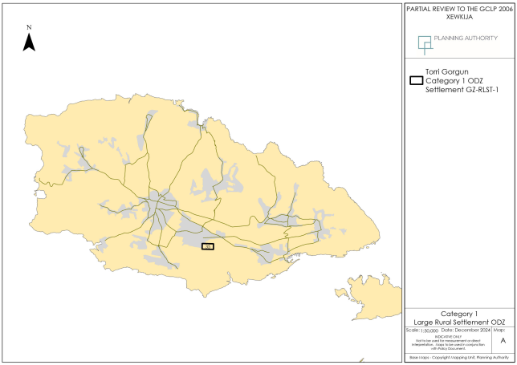
Project analysis slide 2

Slide 17
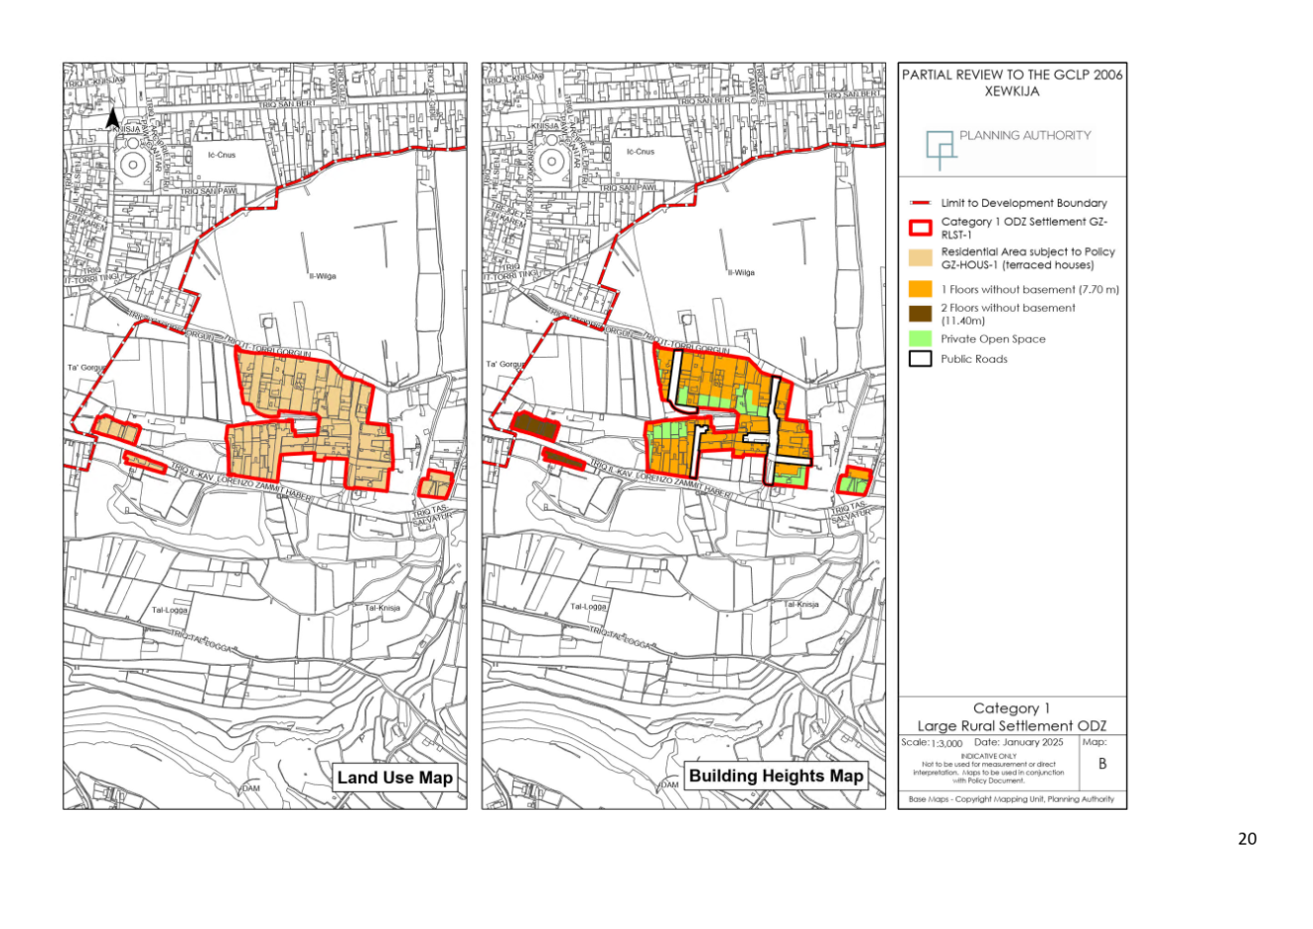
Project analysis slide 2

Slide 18
2ND STAGE PUBLIC CONSULTATION
Submission of Input
Representations are to be made in writing and sent through email address: consultation-gclp@pa.org.mt
Submissions to the Authority are to be received by Monday 5th May 2025
We thank you for your input.

