Slide 1
Partial Local Plan Review of the
2006 Local Plan Policies for Rural Settlements
Public Consultation Draft
Presentation to the Parliamentary Standing Committee for the Environment, Climate Change and Development Planning
9th April 2025

Slide 2
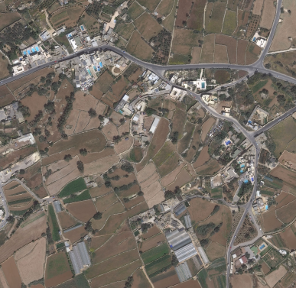
Introduction
Partial Review intended to revise Local Plan policies related to Category 2 and 3 rural settlements,
GCLP policies GZ-RLST-2 & GZ-RLST-3
NWLP policies NWRS 3 & NWRS 4
CMLP policy CG04
SMLP policies SMSE07 & SMSE08

Slide 3
Background
Clusters of residential development ODZ have been recognised as distinct settlement typology since 1995 MBLP and the 1997 GHLP.
The GCLP, NWLP, CMLP and SMLP elaborated on the concept.
2014 - Government adopted the Rural Policy and Design Guidance and repealed other policies that controlled development ODZ.
Paragraph 0.24 states, “the policies contained [in the RPDG14] supersede any conflicting provisions concerning Categories 1, 2 and 3 rural settlements“.
RPDG14 Paragraph 0.24 was struck down by the Court of Appeal on the basis of Article 52 of the DPA. Since RPDG 14 is at the bottom of the hierarchy of plans and policies the RPDG cannot prevail over the Local Plans.
Since, in the absence of guidance by local plans rural settlement policies in relation to ancillary facilities, the provisions of subsidiary policies such as the RPDG14 have been applied to rural settlements, anomalies in decision making have resulted.
The four local plans under review adopted a separate approach with regards to the rural settlements’ boundary delineation in the respective maps. This lack of consistency in the designation of rural settlements boundaries has led to different approaches to the application of policies particularly in category settlements 2 and 3.

Slide 4
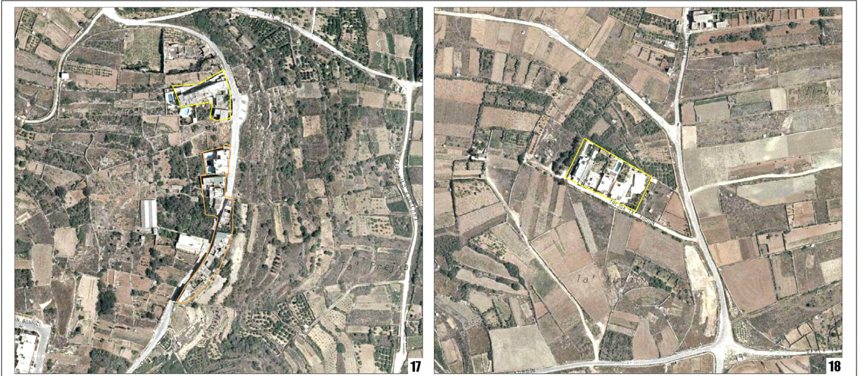
Settlement Boundaries in GCLP

Slide 5
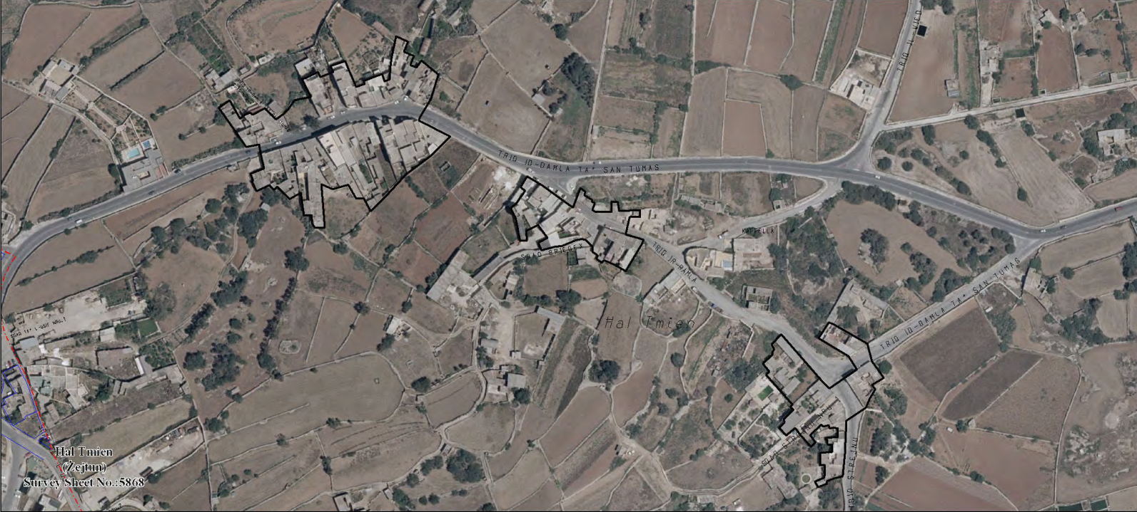
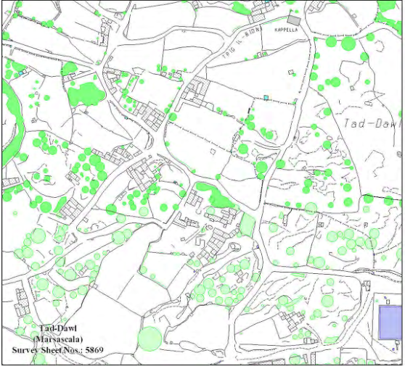
Settlement Boundaries in SMLP

Slide 6
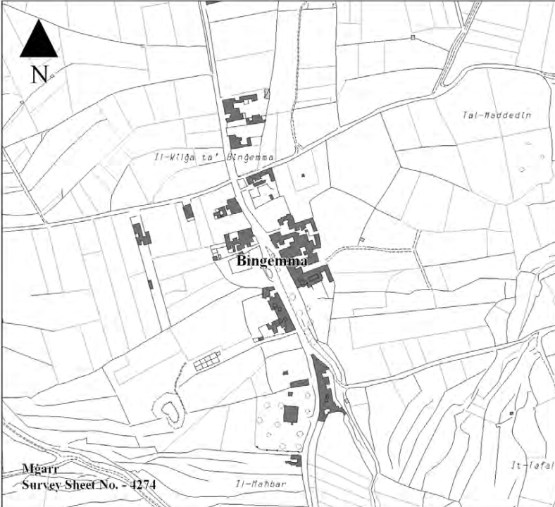
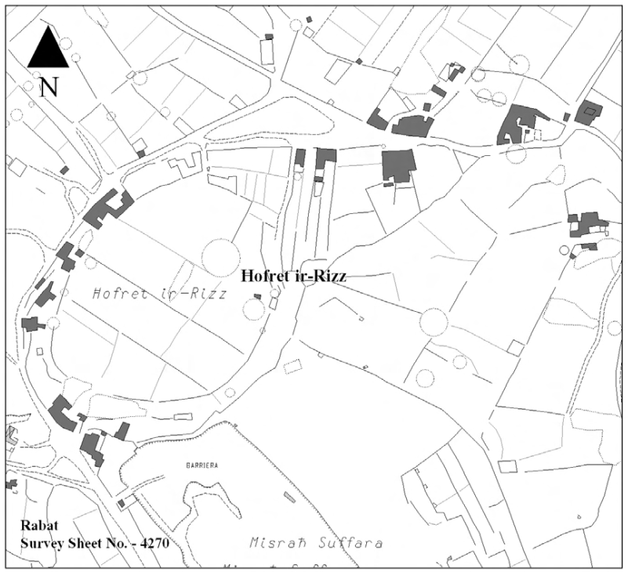
Settlement Boundaries in NWLP

Slide 7
Objectives
In terms of Article 41(2) of the Development Planning Act 2016 (Cap 552), the Minister is requesting the Planning Authority to carry out a partial review to the Gozo and Comino Local Plan (2006), North West Local Plan (2006), Central Malta Local Plan (2006) and the South Malta Local Plan (2006) with the following objectives:
To amend the policies for Category 2 and Category 3 Rural Settlements in the four local plans to clearly set out:
the acceptable development considered as ancillary to a dwelling in Category 2 and 3 Settlements
the take up of fresh land in Category 3 Settlements for development considered as ancillary to a dwelling

Slide 8
Public Consultation on Objectives
The public consultation exercise was carried out between the 10th of October 2024 and the 6th November 2024 and generated nine public submissions.
Five of the submissions were by private individuals
Four submissions were by
ERA,
Moviment Graffiti,
Din l-Art Helwa, and
Partit Nazzjonalista

Slide 9
Main Issues raised by submissions
The inclusion of ancillary facilities to tourism accommodation as a permitted use in Category 2 & 3 Rural Settlements.
Objections to the review, as it is intended to accommodate the needs of few individuals.
Objections to the inclusion of ancillary facilities, as pools and deck areas are not required in order to improve the living standards of dwellings in rural settlements.
Policy reviews should be aimed at improving the standard of living and sustainable development.
A context-based approach should be adopted, rather than a one-size-fits-all policy revision.
No additional development should be permitted on valley sides, ridges, natural habitats, geological features and other environmentally important sites.
A general presumption against ancillaries which would adversely affect the rural character of the settlement and the take up of undeveloped land.
Permitted uses should not be extended otherwise the review will be used to sanction illegalities.

Slide 10
Policy Revisions – Category 2 Rural Settlements
Applicable to GZLP policy GZ-RLST-2, NWLP policy NWRS 3, CMLP policy CG04, and SMLP policy SMSE 07
Dwelling units (new units on uncommitted land, redevelopment of existing buildings, extensions to existing buildings for residential use, and rehabilitation of existing buildings for residential use) together with amenity structures shall be permitted provided the criteria outlined below are met: provided the units satisfy the following conditions
Insofar as dwelling units are concerned:
the resultant unit does not create a building with more than 150m² footprint measured externally at ground floor including any internal courtyards;
the resultant unit occupies an area which is have not less than 120m² and not more than 200m² total floorspace measured externally;
the resultant unit has have an independent access from any other residential unit;
the resultant unit does not do not create a building which is higher than two floors without basement above road level at any point along the street frontage provided that it would and it does not have a detrimental affect on the character of the settlement and the surrounding rural landscape;
structures at roof level do not have a floorspace of more than 20m² measured externally, do not exceed an overall height of 12 courses measured externally from the lowest roof level, and are located to minimise their visual impact;

Slide 11
Policy Revisions – Category 2 Rural Settlements
have a high quality design aimed at retaining and enhancing the existing character of the settlement and which demonstrates that due attention has been given to the impact of the new building on the rural character of the settlement and which complies with any eventual Settlement Design Statement prepared by MEPA;
vi. the resultant unit, if new, shall be served with provided on site parking for not more than two car-spaces
Insofar as amenity structures are concerned, these shall serve a dwelling unit and limited to:
i. tool sheds which are not to exceed 10 m² and an overall height of 2.75m measured externally and/or animal enclosures not to exceed 25 m² and an overall height of 3.5m measured externally and together shall not occupy more than 10% of the area of the curtilage of the dwelling whichever is the lower;
ii. swimming pools and deck areas which shall not exceed 75 m² in total area;
iii toilets, showers and/or changing rooms which do not exceed a height of 2.5m and a combined floor space of not more than 6 m².

Slide 12
Policy Revisions – Category 2 Rural Settlements
Provided further that:
amenity structures shall be located within a reasonable distance from the dwelling unit;
all permitted interventions shall have a high quality design aimed at retaining and enhancing the existing character of the settlement and which demonstrates that due attention has been given to the impact of the new building/s on the character of the settlement and its surrounding rural environment.

Slide 13
Policy Revisions – Category 2 Rural Settlements
Other generic changes to the Policies
References to MEPA have been changed to PA
Permissible land uses, definition of uncommitted land have not been changed.
The requirement of the preparation of Settlement Design Statements for each settlement, has been deleted
References to the Policy & Design Guidance on Agriculture, Farm Diversification and Stables (2005) replaced by the Rural Policy and Design Guidance, 2014 and future amendments
General changes to policies supporting text
Reference to amenity structures has been integrated in the supporting text
Reference to Settlement Design Statements has been deleted

Slide 14
Policy Revisions – Category 2 Rural Settlements
In the case of CMLP policy CG04
This policy relates only to the rural settlements of Bidnija and Maghtab,
Cross reference in the policy and supporting text has been made to the Partial Review to the CMLP (2006) - Maghtab Planning Strategy Area and Map MTB1 which forms part of this partial review
Reference in supporting text to Legal Notice 12 of 2001 has been replaced by reference to Subsidiary Legislation 549.64
In the case of SMLP policy SMSE 07
No development in the form of extending the built up footprint of the existing building or a completely new development will be permitted in the back gardens forming part of buildings falling within the Category 2 Rural Settlements other than amenity structures.

Slide 15
Policy Revisions – Category 3 Rural Settlements
Applicable to GZLP policy GZ-RLST-3, NWLP policy NWRS 4, and SMLP policy SMSE 08
New development which takes fresh land in Category 3 settlements is not allowed unless it qualifies as an amenity structure allowed under Category 2 Settlements.New development, which takes up fresh land, notwithstanding the location of the site in relation to existing buildings, will not be permitted. The definition of uncommitted land, which is available for development in Category 2 Rural Settlements, is not applicable to Category 3 Rural Settlements.
General changes to policies supporting text
Restrictions on site planning, floor spaces, building heights, and car-parking provision and provision of amenity facilities are being introduced to ensure that all new development for residential purposes will not create unacceptable environmental impacts.

Slide 16
2nd Stage Public Consultation
Submission of Input
Representations are to be made in writing and sent through email address:
consultation-ruralsettlements@pa.org.mt
Submissions to the Authority are to be received by Monday 5th May 2025
We thank you for your input.

