Slide 1
Partial Review of the
NHLP 2006 for Villa Rosa
Presentation to the Parliamentary Standing Committee for the Environment, Climate Change and Development Planning
14th May 2025

Slide 2
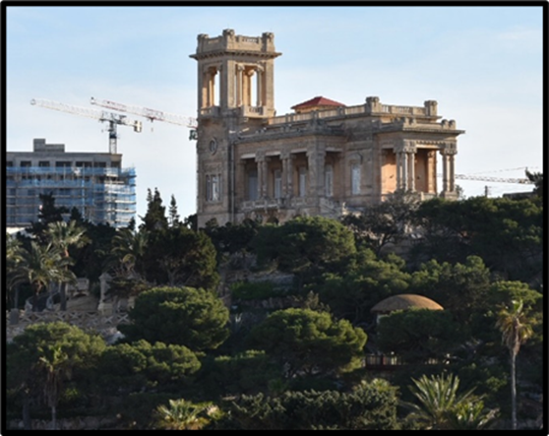
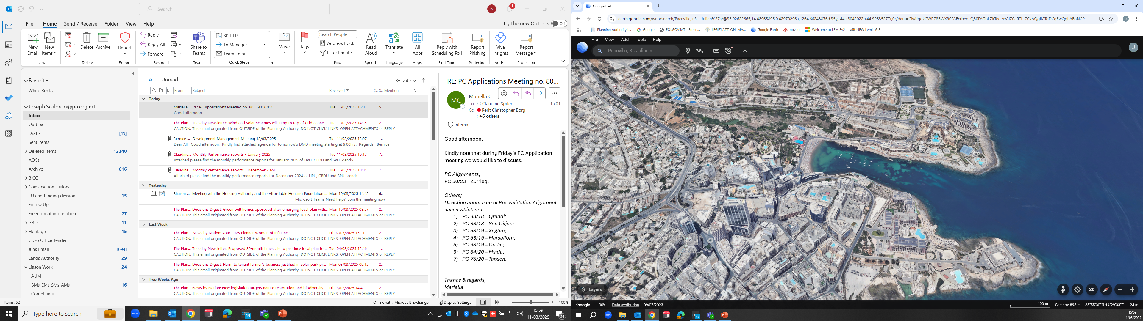
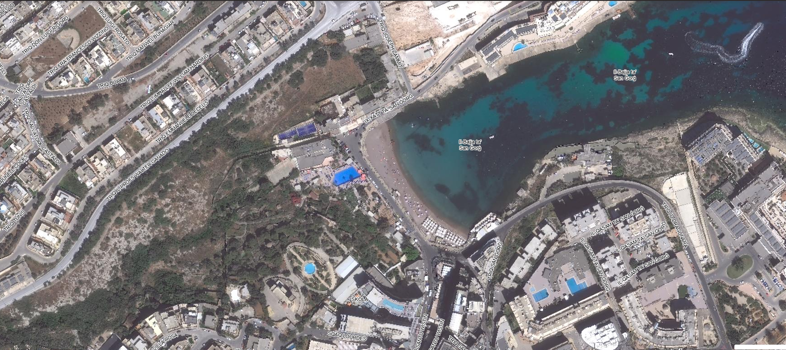
Existing
Site

Slide 3
Minister’s Objectives of
October 2024
1. To better protect the environmentally sensitive areas, buildings, features, and public access within the site shown on Map;
2. To ensure that development is strictly restricted within the site boundaries shown on Map and that it does not create unacceptable environmental impacts on the surrounding environmentally sensitive areas, buildings, features and recreational spaces;
3. To re-configure the boundaries of the sub-zones within the site without any changes to the overall site boundary shown on Map and allocate the land uses within the redefined zones to identify the:
a. minimum areas of public open space which must exceed the current allocations in the local plan;
b. minimum areas of private open space;
c. zones where higher quality hotels shall be allowed;
d. zones where residential development shall be allowed;
e. zones where a mix of uses (office, retail and catering and other appropriate uses) shall be allowed;
f. location of carpark/s;
4. To clearly establish the allowable building heights for each sub-zone, including through the application of the Height Limitation Adjustment Policy for Hotels of 2014;
5. To establish the maximum allowable overall Gross Developable Floorspace (GDF) organised also by sub-zone and by land use;
6. To identify any further impact assessment studies which may be required at project stage, without prejudice to any statutory requirements.

Slide 4
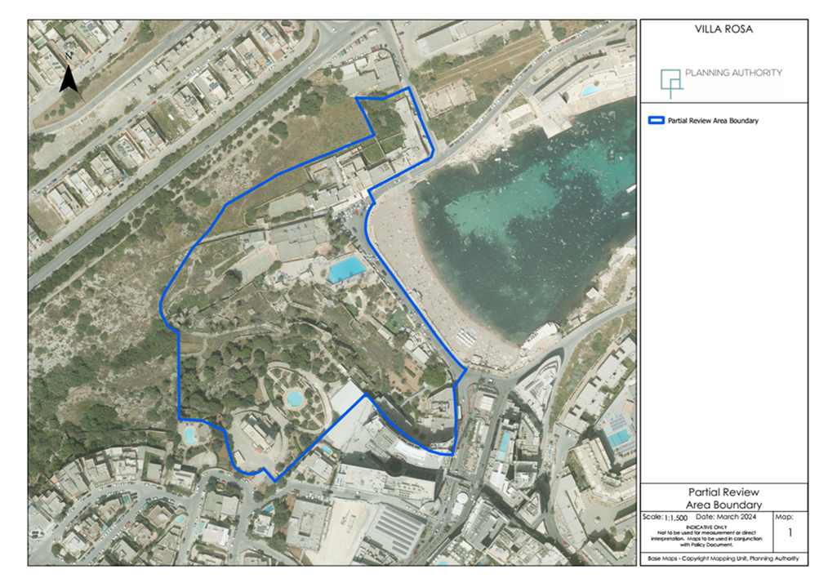
Site Boundary

Slide 5
Public Consultation
Government’s objectives were published for public consultation for a period of six weeks between the 15th of October 2024 and 25th of November 2024
4,318 submissions received
4,212 submissions included the same text which supported the objectives for the partial local plan review for the Villa Rosa site
Garnet Investments Ltd as owners of the land commented that they are aligned with the principles of the objectives as published and commented that the principles of the Hotels Height Adjustment Policy should be included in the text of the local plan policy
The Bay Street Group requested the extension of the local plan review boundaries so that Baystreet will not remain sandwiched between one of the Villa Rosa Towers and Sqaq Lourdes.

Slide 6
Public Consultation
106 other submissions were received from private individuals, NGOs and Government entities (the Environment and Resources Authority, the Light Pollution Awareness Group and the Astronomical Society of Malta, the St. George’s Park Owners Association, the Interdiocesan Commission on the Environment, Flimkien ghal Ambjent Ahjar, the Swieqi and the Pembroke Local Councils, Nature Trust, Din l-Art Helwa and from Partit Nazzjonalista) with 43 being of identical text.

Slide 7
Issues of Public Concern
The issues raised by the public submissions were:
the lack of transparency about the reason for the review which leads to the conclusion that it is aimed to facilitate the project proposed under PA7254/22
the review is an ad-hoc approach to planning when a comprehensive review of all local plans and the SPED is required
hotels should not be given a preferential treatment but should still respect residential amenity, scenic or environmentally sensitive sites
the lack of a carrying capacity study for more hotel beds in Paceville and at national level
high rise buildings are not the only hotels which can attract quality tourists. FAR policy for tall buildings needs to be re-hauled
the development shall have an adverse impact on the valley and cave and the historic building, shall create a visual intrusion and over-shadowing and pollution, increase traffic and result in over-development. Impact assessments should be carried out as part of the review process and exceedance of limits should not be allowed
the local plan should quantify the financial contribution by the developer for mitigating impacts
the review should be in line with SPED and the Public Domain Act.

Slide 8
Current Policy – SPED 2015
Key relevant strategic policies related to the location, land uses and characteristics of the Villa Rosa Regeneration Area and its surroundings are SPED policies TO1.2, UO1.1a, UO1.5 and UO1.6 which safeguard prime tourism sites, designate the Principal Urban Area (PUA) to accommodate major employment needs, guide new jobs to Business (tourism) Hubs and promote the attractiveness of these hubs to accommodate new jobs.

Slide 9
Current Policy – SPED 2015
These policies which promote socio-economic development in the urban area, need to be balanced with policies TO8.2, TO8.4, TO8.7 and UO3.7 which safeguard protected areas, support the restoration of damaged ecosystems, control activities which might have an impact on areas, buildings and structures of ecological, geological and cultural heritage value and protect green open spaces which contribute towards the character and amenity of urban areas.

Slide 10
Current Policy – SPED 2015
Furthermore, account must be taken of policies TO4.3, UO4.3, UO4.6 and UO4.7 which require improvement in the quality and quantity of utilities infrastructure, design of buildings and infrastructure to make efficient use of energy and resources and reduce waste, the integration of the requirements of people with special needs in the design of buildings and sustainable urban drainage systems.

Slide 11
Current Policy – NHLP 2006
Zone A: High density tourism and leisure uses on four floors from the lower road level with public carpark
Zone B: High density tourism and leisure uses on six floors plus overlying penthouse but without semi-basement terracing down to two floors without semi-basement
Zone C: Low density catering, retail and leisure uses on two floors with 50% site coverage and managed public access
Zone F: Low density tourism/residential accommodation with a maximum of 15 bungalows on 170sqm built footprint each and total site coverage of 25% and managed access
Zones D, E and H: safeguard the villa and its immediate garden settings
Zone G: semi-pedestrianisation of St. George’s Bay shoreline

Slide 12
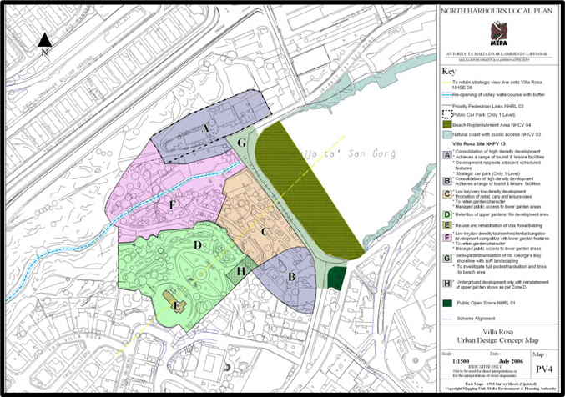
Current Policy – NHLP 2006

Slide 13
Current Policy – FAR 2014
The objectives of this planning policy guidance are, amongst others, to define a tall building and indicate preferred uses and appropriate strategic locations for tall buildings. The policy defined a tall building as higher than 10 floors, included hotels in the list of preferred uses for tall buildings and identified the locality of Paceville as an appropriate location for tall buildings with a preference for the tourism and entertainment zones designated in the Local Plan. Paceville’s hotel and entertainment zones include the Villa Rosa site.

Slide 14
Current Policy – Hotels Heights Policy 2014
In the case of 3/4/5-star hotels, two additional floors over and above the number of floors permitted in the Local Plan could be considered under specified conditions.
The allowable height of the hotel building could be more than two additional floors over and above the height limitation permitted in the Local Plan provided that the site area is not less than 5,000sqm or is surrounded by existing or planned roads or the site accommodates standalone buildings.
Zones A and B allocated for high density tourism development on the 2006 Villa Rosa Urban Design Concept Map PV4, July 2006 are larger than 5,000sqm, or have potential to accommodate a standalone building. Therefore, for these two zones, in principle, current policies set no capping on building heights, and consequently the gross developable floorspace.

Slide 15
Revised Policy NHPV 13
Policy NHPV13 in this partial review shall replace the provisions of the 2006 policy NHPV13 – Villa Rosa and the provisions of 2006 policies NHTR14, NHPV01, NHPV03, NHPV07 and NHPV09, in so far as they relate to the Villa Rosa site as identified in this review.
The provisions of revised Villa Rosa Urban Design Concept Map PV4 in this report shall replace the Villa Rosa Urban Design Concept Map PV4 in the 2006 North Harbours Local Plan.
The provisions of revised Villa Rosa Urban Design Concept Map PV4 in this report shall also replace the provisions in the General Transport Strategy Map TR1, Paceville Policy Map PV1; Paceville Building Heights & Urban Design Map PV2; Area of Traffic Restraint Within Paceville Map PV3 in the 2006 North Harbours Local in so far as they relate to the Villa Rosa site as identified in this review.

Slide 16
Revised Policy NHPV 13
Revised Policy NHPV13 is organised into five components:
  Designation of site
  Development Strategy – environmental safeguards, urban design, impact assessments
  Implementation Policies – detailed requirements, public open space, ecological area, upper gardens area, Villa Rosa building, pedestrianisation
  Policy Map – delineation of 12 zones with primary/ancillary land uses and floorspaces for each
  Development Framework Summary Table

Slide 17
Revised Policy NHPV 13 - Designation
Villa Rosa Regeneration Area designated for a high-quality tourism destination.
Must be designed comprehensively by an integrated master plan approved through a single development application.
Development applications which do not cover all the land area may be considered provided the objective of achieving an integrated master plan is not compromised.

Slide 18
Revised Policy NHPV13 – Strategy (Environmental Safeguards)
To ensure that development is strictly located within the site boundaries shown on Map PV4.
To open the site shown on Map PV4 for public access and recreational use and ensure public access to the valley.
To protect the environmentally sensitive areas, buildings and features within the site shown on Map PV4, particularly the Grade 1 Villa Rosa, the Level 1 Harq Hammiem Cave and its buffer.
To ensure that development does not create unacceptable impacts on the environmentally sensitive areas, buildings and features surrounding the site shown on Map PV4, particularly the military Guardroom, the Level 1 Harq Hammiem Cave and its buffer, and the Level 1 Wied Harq Hammiem Area of Ecological Importance and its buffer.
To ensure that development does not create unacceptable impacts on the valley and on St. George’s Bay sunbathing and swimming area.

Slide 19
Revised Policy NHPV13 – Strategy
(Urban Design)
To adopt high standards of architectural quality and environmental sustainability in the design of buildings and open spaces, including low energy techniques, heat recovery systems, second class water recycling facilities, waste management and recycling schemes, run off reduction and collection measures, use of RES, passive measures such as natural ventilation, and integration of green/blue infrastructure.
To promote designs that ensure that any resultant shadows are moving and temporary.
To ensure that the total Gross Developable Floorspace on all levels of the development, does not exceed the floorspaces established by this policy.

Slide 20
Revised Policy NHPV13 – Strategy
(Impact Assessments)
To determine all utilities infrastructure upgrading requirements to support the regeneration of the Villa Rosa site, including transport infrastructure both private and public, through the appropriate Infrastructure Impact Assessments and Traffic Impact Assessments and adopt specific mitigation measures or make monetary contributions towards their implementation.
To identify potential unacceptable impacts on the surrounding community through a Social Impact Assessment and adopt specific mitigation measures or make monetary contributions towards their implementation.

Slide 21
Revised Policy NHPV13 – Implementation Policies
(Detailed Requirements)
“Other” permissible land uses shall include uses which are deemed compatible, by the Planning Authority, with the primary land uses identified for each zone, excluding the land uses which are identified as primary uses to be located in another zone by the Development Framework.
All current road and building alignments within the site boundary established in policy Map PV4 are repealed and shall be established by the master plan. Master plan may include minor realignment of zones.
Building heights shall comply with this policy. Hotels Policy applicable on Zones A1, A2 and A3 only subject to overall capping of heights.
Green roofs on Zone H are compulsory.

Slide 22
Revised Policy NHPV13 – Implementation Policies
(Public Open Space)
Zone F is designated for public use, shall be landscaped and shall never be less than 3,830sqm.
Excavations below this zone shall only be allowed for underground carparks, servicing areas and proper vehicular circulation without prejudice to requirement of restoration of the valley watercourse through Zone F.
Bridging over the public space by buildings to connect zone A1 with zone A3 may be considered favourably provided the openness of Zone F and local views from the bay towards the valley are not compromised and the design of the resulting building is of an exceptional quality. GDF shall not be exceeded. The footprint of the bridged over area shall not exceed 20% of the footprint of this Zone and may consist of buildings which shall be used as the buildings forming part of Zone A1 and Zone A3.
Commercialisation of this Zone shall not be permitted.
1,275sqm of public open space shall be provided on Zone C.

Slide 23
Revised Policy NHPV13 – Implementation Policies
(Ecological Area)
(Upper Gardens)
(Villa Rosa)
(Pedestrianisation)
Zone B (ecological area) safeguarded from development and shall never be less than 2,570sqm. An ecological restoration method statement shall be submitted detailing how the ecological status of the site shall be improved and maintained to the satisfaction of ERA.
Zone D (upper gardens) is safeguarded for rehabilitation and conservation.
Zone E (villa rosa), the existing Villa Rosa, requires a full rehabilitation programme which respects the historic and architectural detailing of the Villa in accordance with the scheduled status of the building and its prominent location. Any development is to safeguard the strategic view line onto Villa Rosa as indicated on policy Map PV4.
Zone G (bay shoreline) proposals for the management of traffic on the road space, which may include the full or semi pedestrianisation for public outdoor use, shall be included.

Slide 24
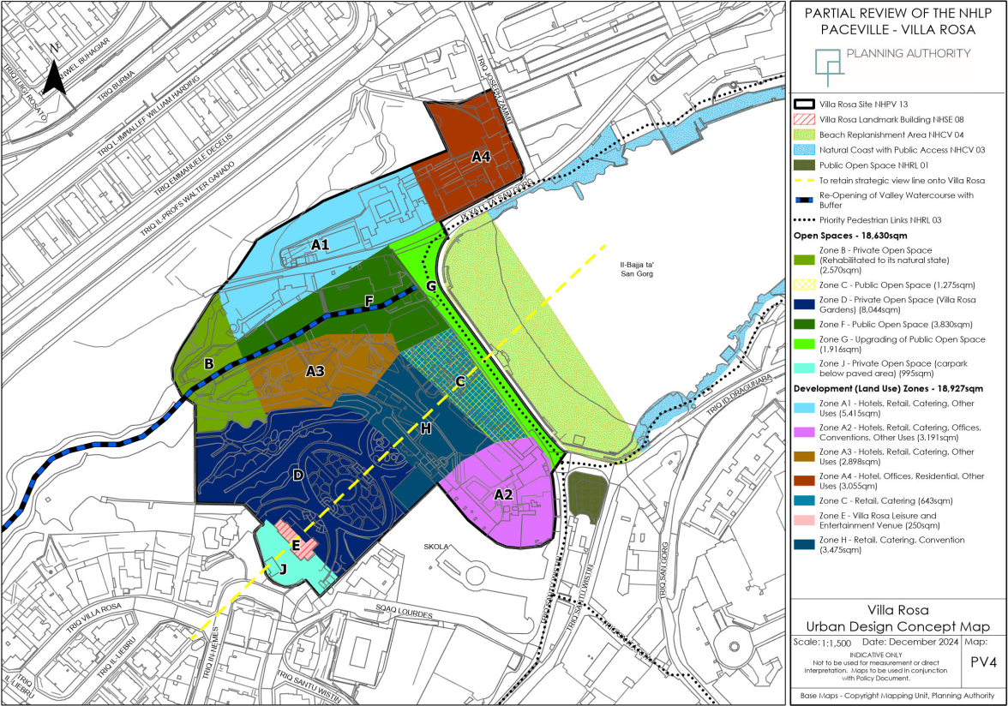
Proposed Policy Map

Slide 25
Development Framework Summary Table
Sub Zone | Site Area (sqm) | Permissible land uses | Maximum Building Height Limitation (floors) | Maximum GDF (Conventional) (sqm) | Maximum Number of Levels (Hotels Heights Policy) | Maximum GDF (Hotels Heights Policy) (sqm)
A1 | 5,415 | Hotels, Retail, Catering, Other | 4 floors with semibasement | 36,550 | 22 | 88,500
A3 | 2,898 | Hotels, Retail, Catering, Other | 4 floors with semibasement | 19,560 | 22
A2 | 3,191 | Hotels, Retail, Catering, Offices, Conventions, Other | 6 floors without semibasement | 27,920 | 39 | 40,300
A4 | 3,055 | Offices, Residential, Hotel, Other | 4 floors with semibasement for a depth of 30m from frontage on Ix-Xatt Ta San Gorg | 17,000 | Not Applicable
 |  |  | 1 floor with semibasement for the remaining frontage on Triq Joseph Zammit
B | 2,570 | Private Open Space (rehabilitated to natural state) | Not applicable
C | 1,918 | Retail, Catering, (643sqm footprint) Public Open Space (1275sqm footprint) | 2 floors without semibasement | 1,800
D | 8,044 | Private Open Space (Villa Rosa Gardens) | Not Applicable
E | 250 | Villa Rosa (Leisure/entertainment venue)
F | 3,830 | Public Open Space
G | 1,916 | Upgrading of public space
H | 3,475 | Retail, Catering, Conventions | 2 floors without semibasement | 6,900
J | 995 | Private Open Space (carpark below paved area) | Not applicable | Not applicable

Slide 26
Conclusion
2nd Stage Public Consultation
Submission of Input
Representations are to be made in writing and sent through email address:
villarosa.consultation@pa.org.mt
Submissions to the Authority are to be received by Wednesday 11th June 2025
We thank you for your input.

